Slide 1

Enhanced Inventory Management
ECE 143 - Group 10
Arjit Verma
Hangyang Shen
Roberto Reyes
Rosie Wang
Sesha Jonnavithula

Slide 2
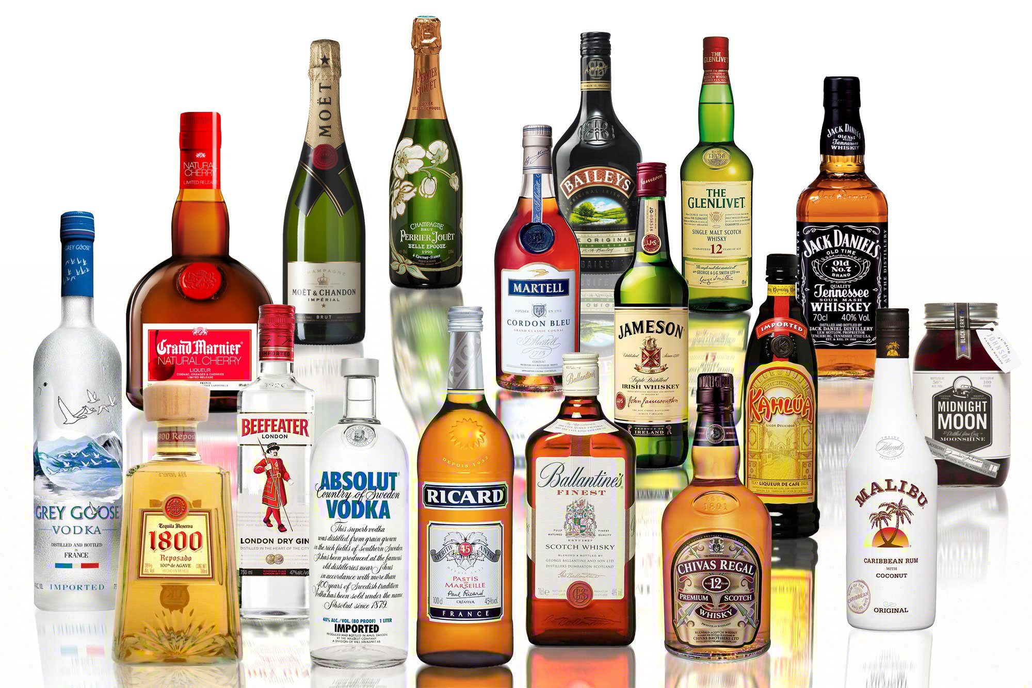
About the dataset - Spirits LLC
A liquor retailer with 79 stores across 67 cities in England.
Inventory data as of 1st January and as of 31st December.
Sales data for the month of January.
Purchase data from 1st January to 31st December.
116 vendors and their invoice data over the year.

Slide 3
Methodology
Process of Data Extraction and Analysis
Cleaning up data and creating coherent data frames from the several csv files.
Proposing hypotheses for correlations and checking if the data supported them.
Understanding the economic factors involved in efficient inventory management.
Understanding and analyzing the data, and plotting any correlations.

Slide 4
Primary Insights

Slide 5
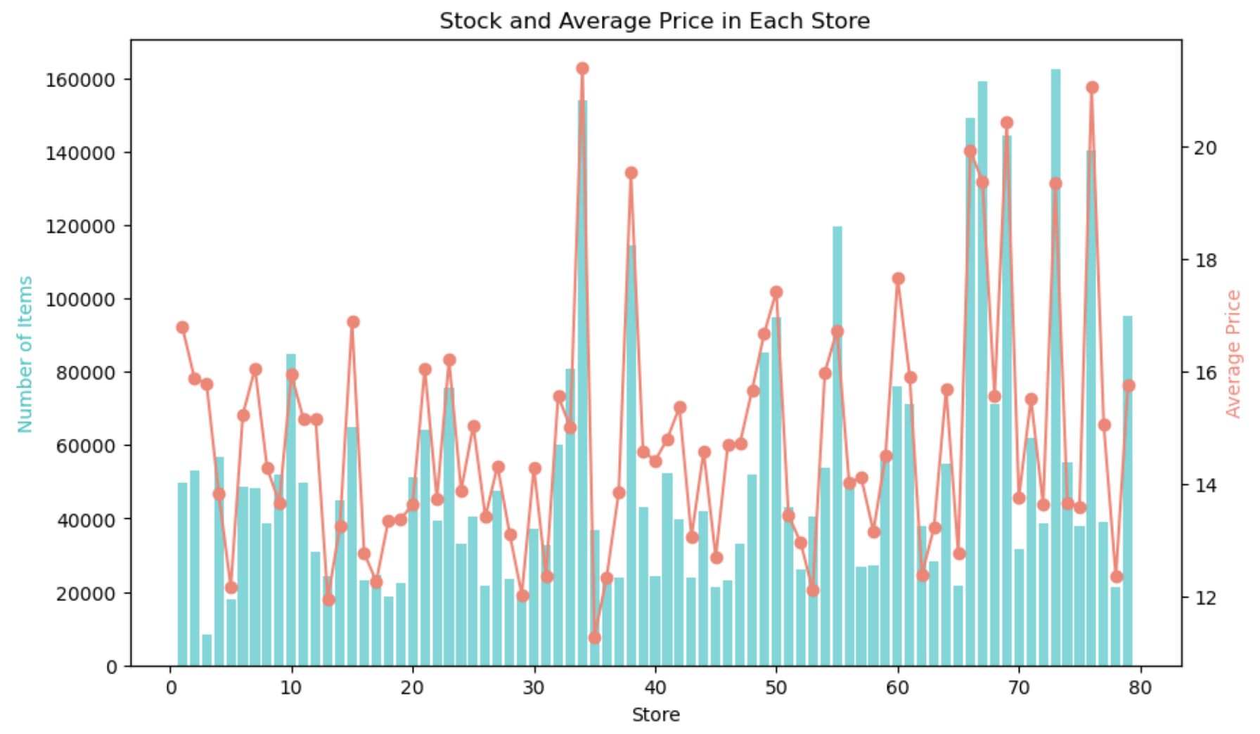
Stock Quantity and Average Price
Observations from Stock Data as of 1st January
Stores do not hold a uniform quantity of stock.
Average price per bottle also differs from store to store.
Stores that held more stock, also had a higher average price per bottle.

Slide 6
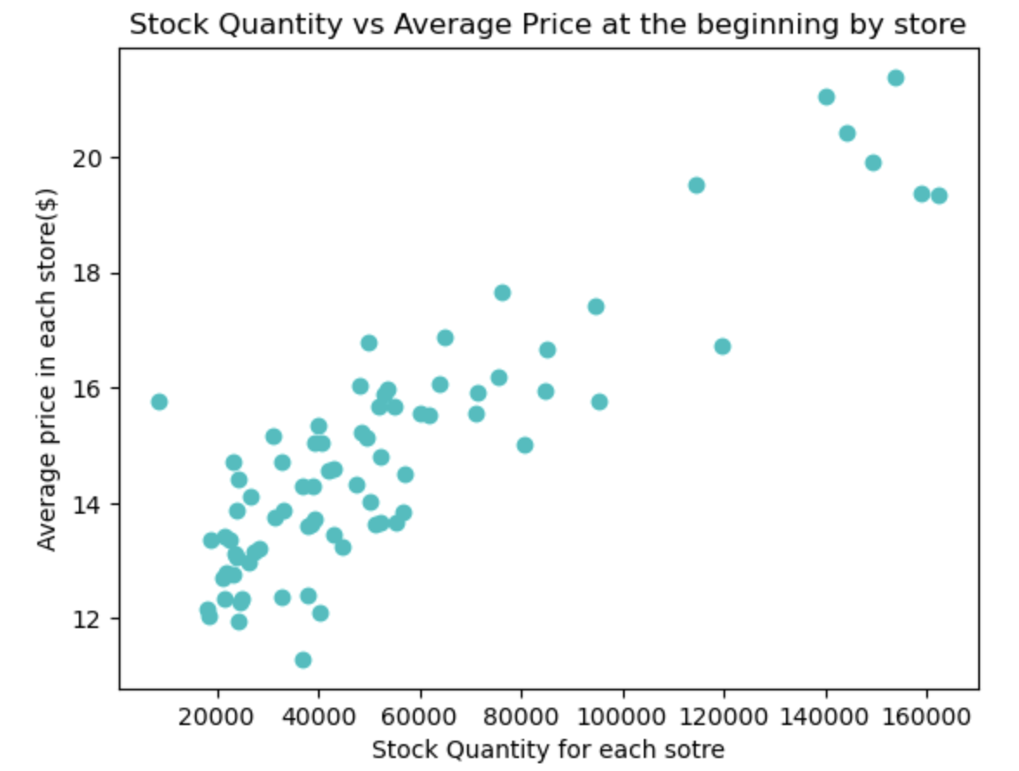
Observed Correlation
88% correlation found
The stock quantity held in each store, is correlated with the average price per bottle held.
Stores holding higher quantities might cater to wider markets.
The larger stores might be more popular with the wealthier drinkers.

Slide 7
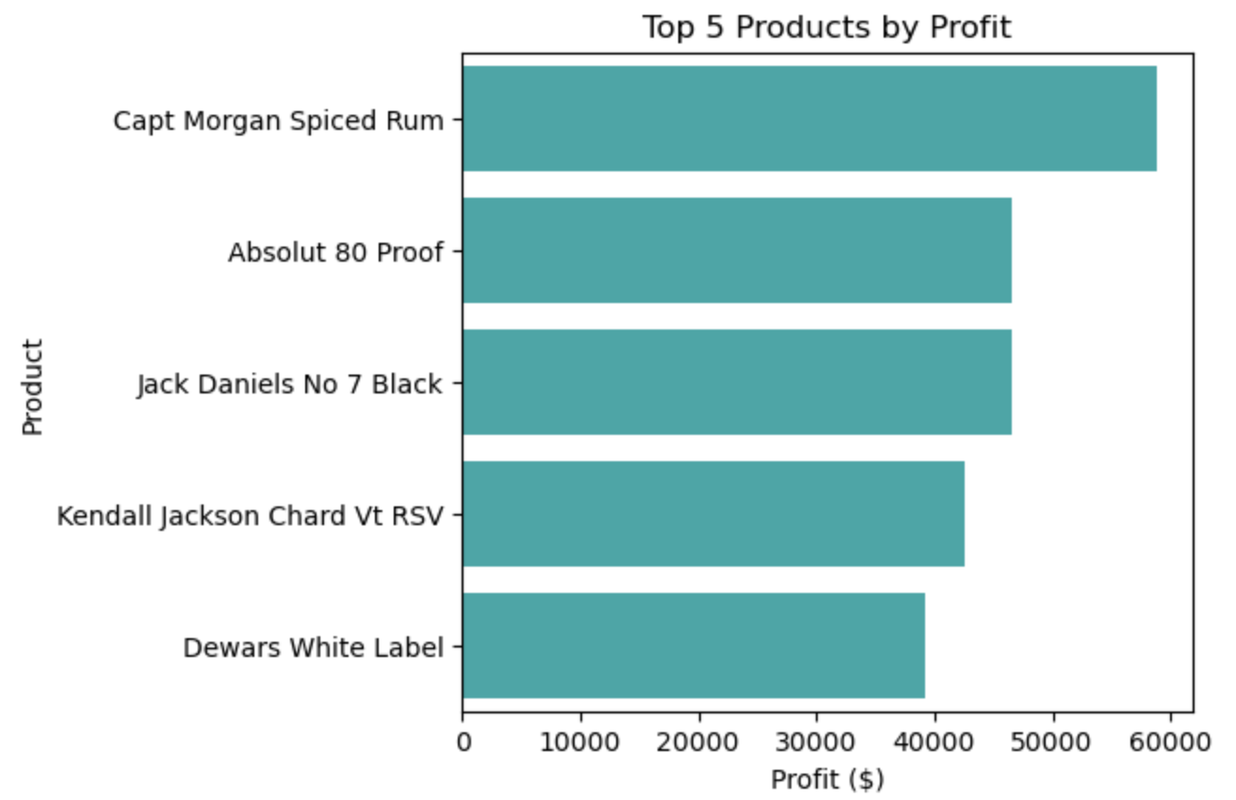
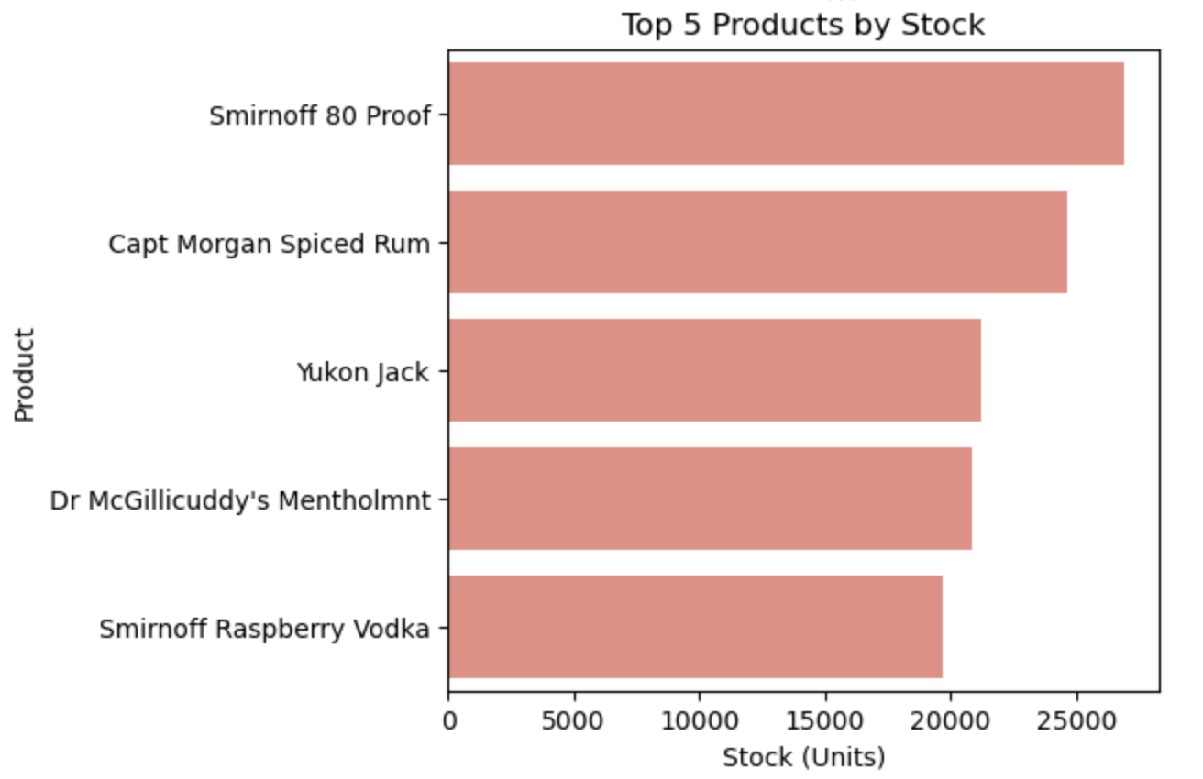
Discrepancy between held stock and profitable stock
Only 1 of the top 5 most profitable products was held in the top 5 quantities
This highlights the need to better manage inventory to optimize profits.
The profitable products may be running out of stock.
The non-profitable/stagnant products may be held in unnecessary quantities.

Slide 8
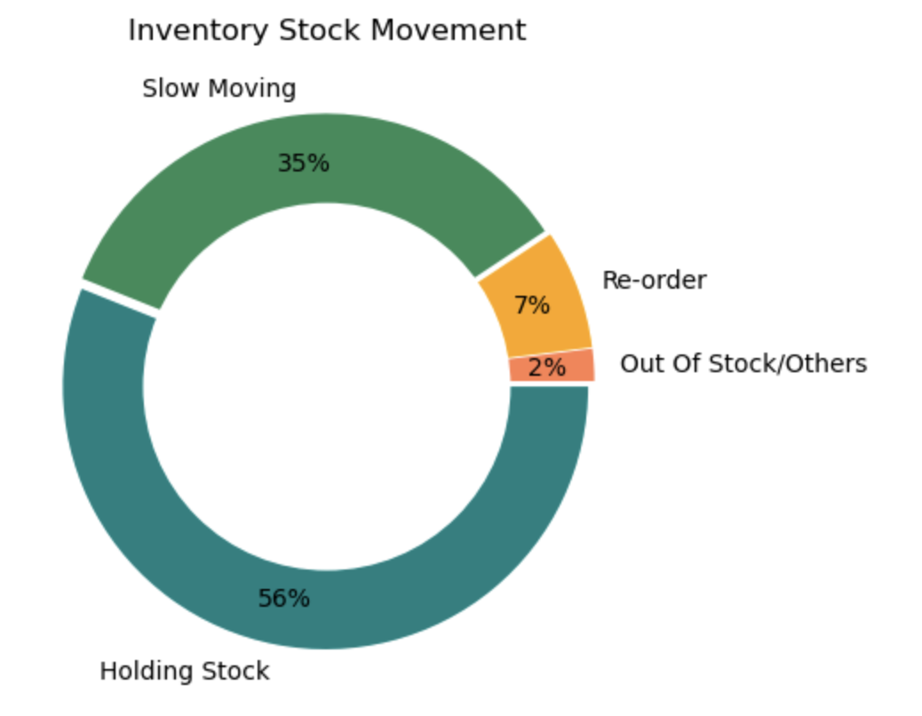
Categorization of Products held in stock
Stock Movement Analysis
Analysed stock movement data from inventory data and purchase data.
Observed that of the products held:
56% of them are ~75% stagnant.
35% of them are slow moving, or are ~30-75% stagnant.
7% are nearing re-order levels with < 30% stock stagnated.
2% have run out of stock.

Slide 9
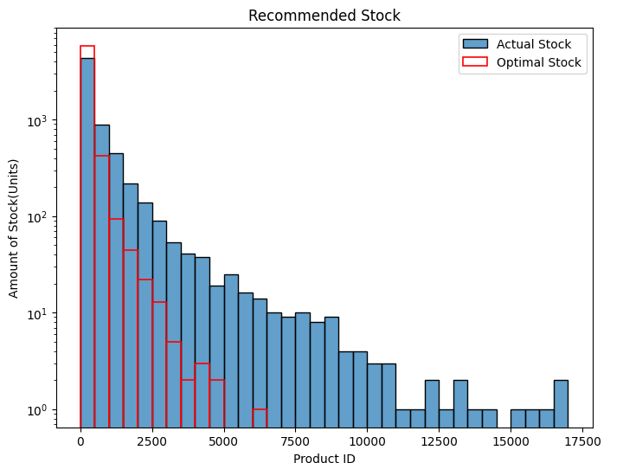
Economic Order Quantity Analysis
Used sales, purchase and inventory data to perform EOQ analysis.
Limited sales data only covered a subset of all products.
For the products covered, we observed:
Select few products were held in insufficient amount.
Majority of products were held in excess.

Slide 10
Sales Insights

Slide 11
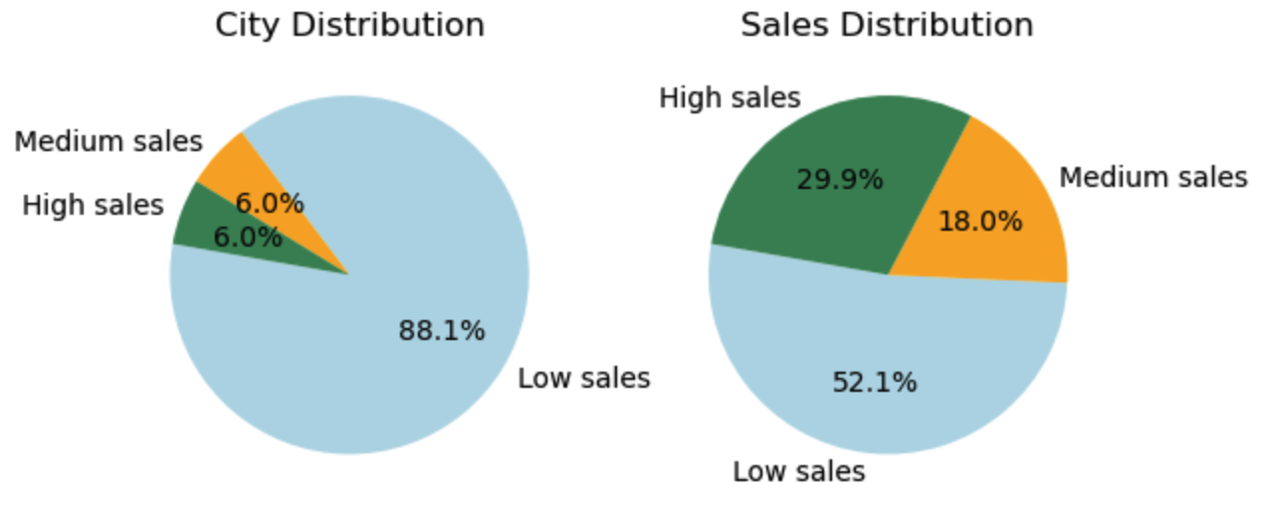
Categorization of Cities by Sales Volume
6% of the cities contributed to 29.9% of the total sales.
5x its weight factor
6% of the cities contributed to 18% of the total sales.
3x its weight factor
88% of the cities contributed to 52% of the total sales.
0.6x its weight factor

Slide 12
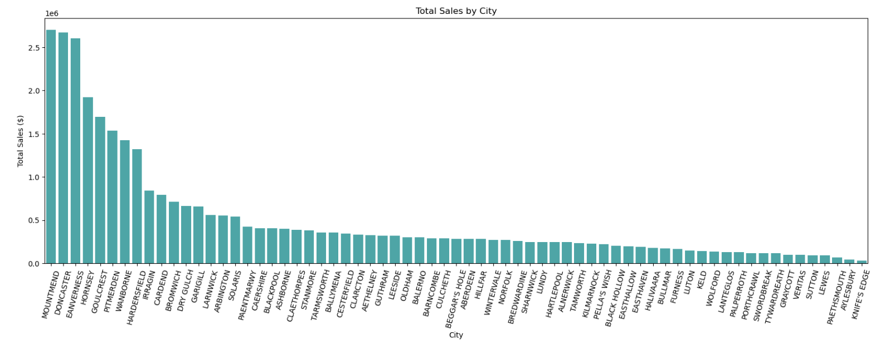
Sales Distribution across Cities
City populations and drinking cultures are major reasons for the uneven distribution.
https://www.teamdoncaster.org.uk/Documents/DocumentView/Stream/Media/Tenant2/Data%20Observatory/Drugs%20Alcohol%20HNA.pdf

Slide 13
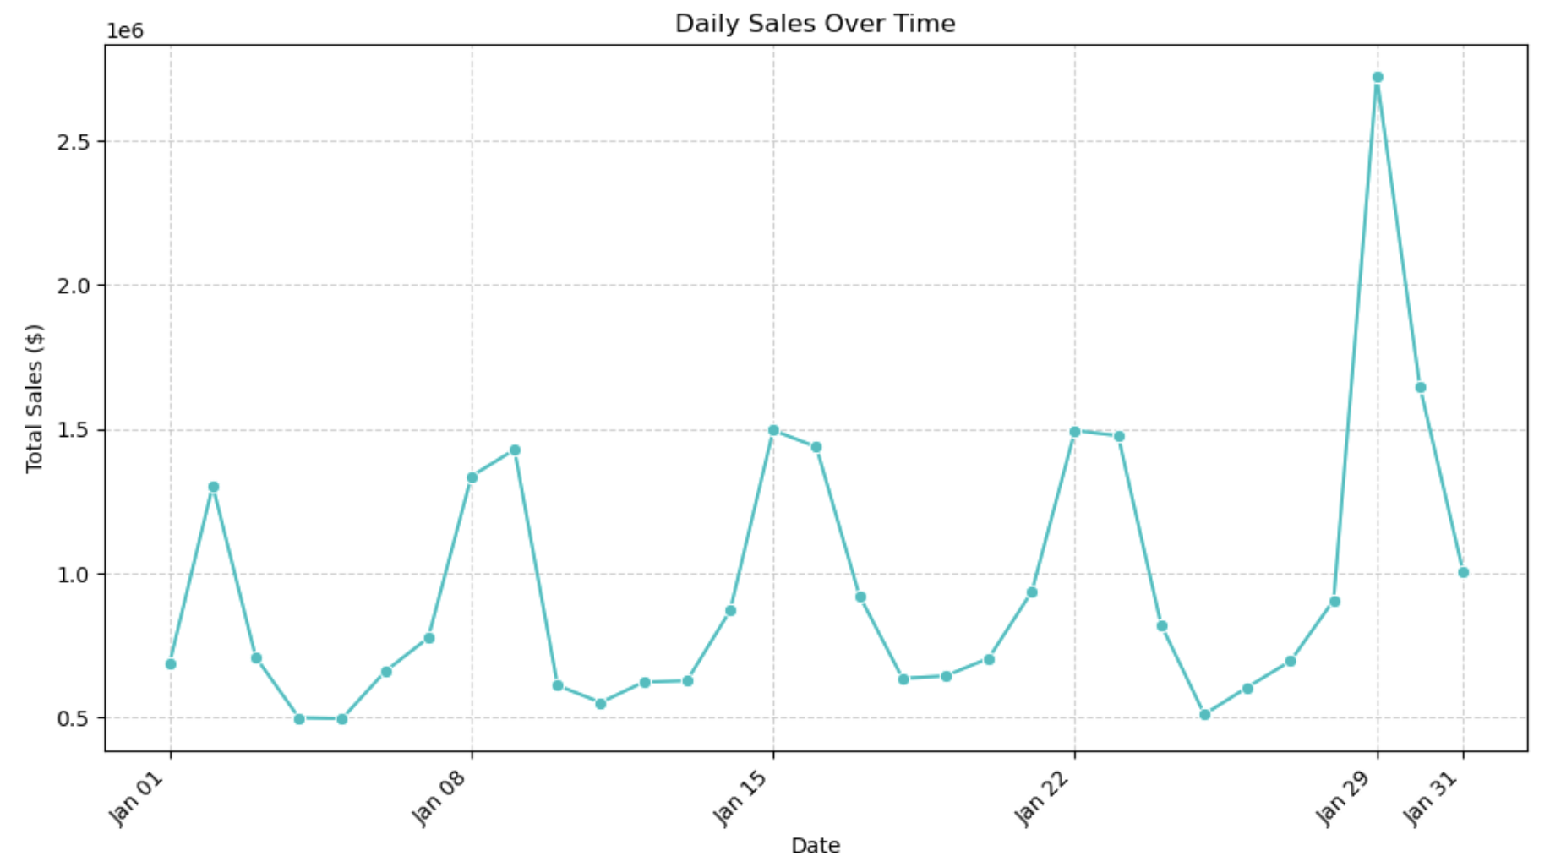
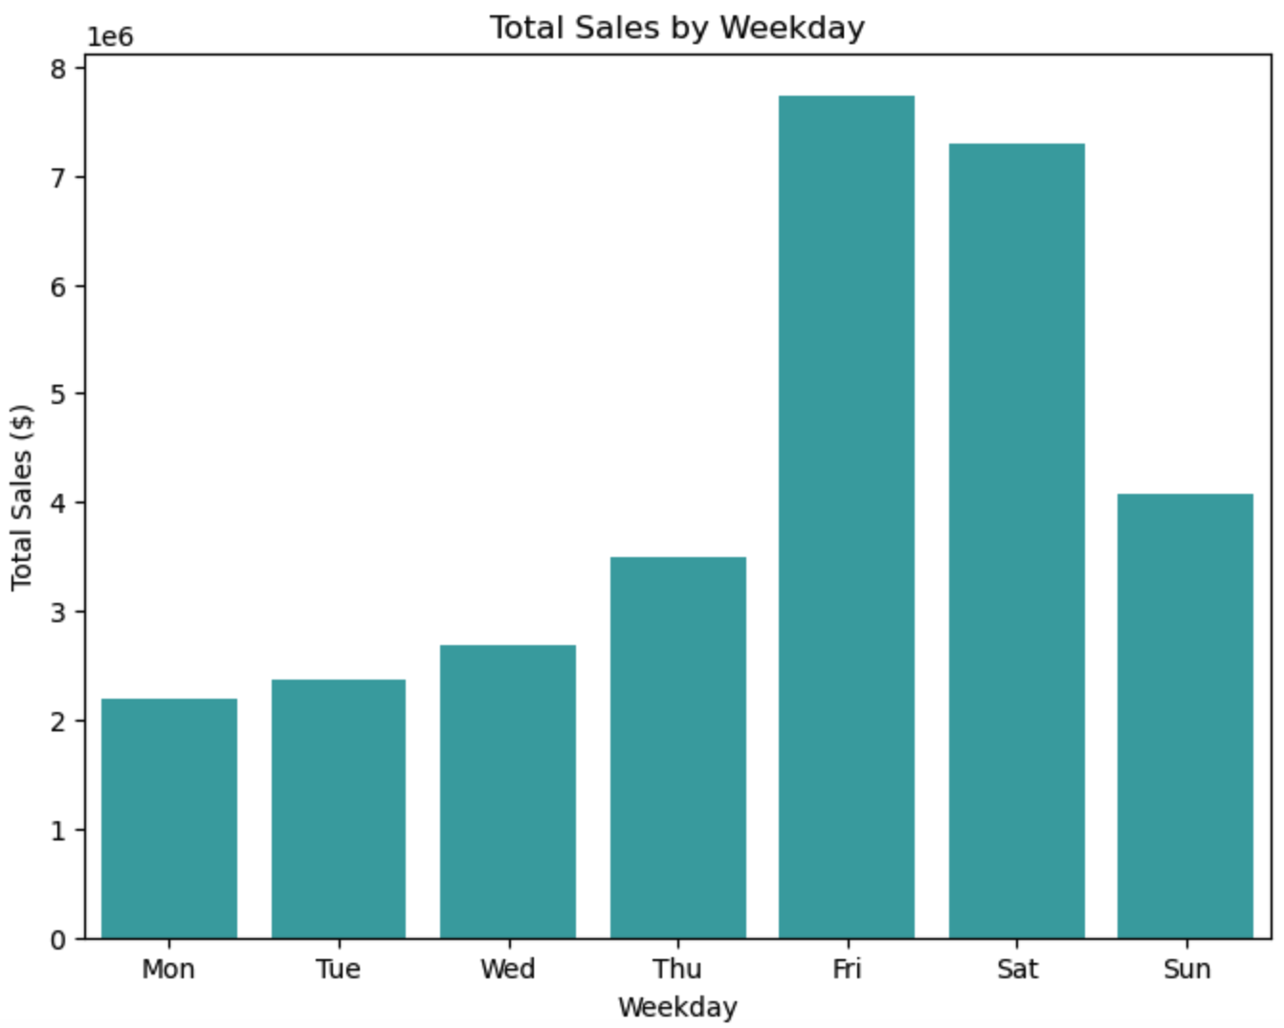
Sales Pattern
Over the month of January, sales followed a very regular pattern.
The last Friday of the month had higher sales, possibly due to salary credits.
This pattern repeated on a weekly basis.
Fridays and Saturdays had significantly higher alcohol sales.
Mondays had the least alcohol sales (no surprises there).

Slide 14
Purchase Insights

Slide 15
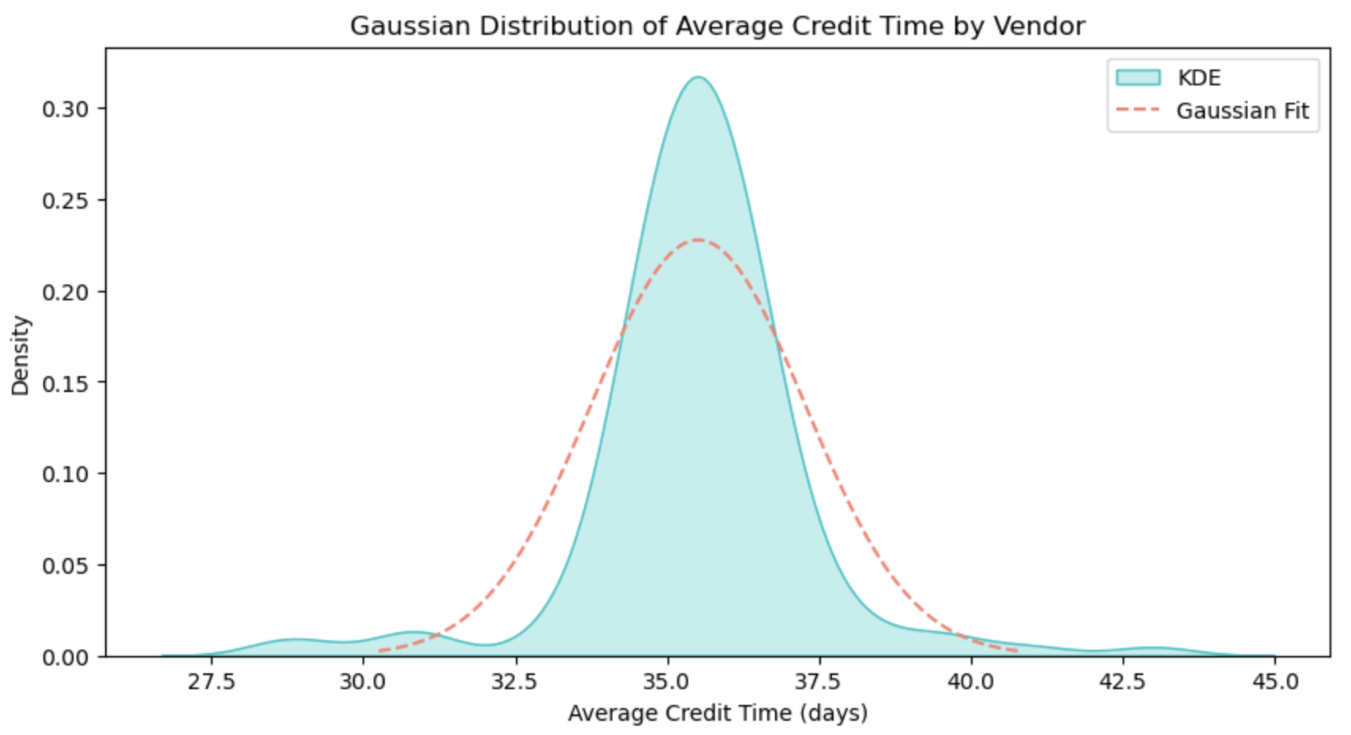
Trade Credit Time for the Vendors
Most vendors seem to extend around 36 days of trade credit.

Slide 16
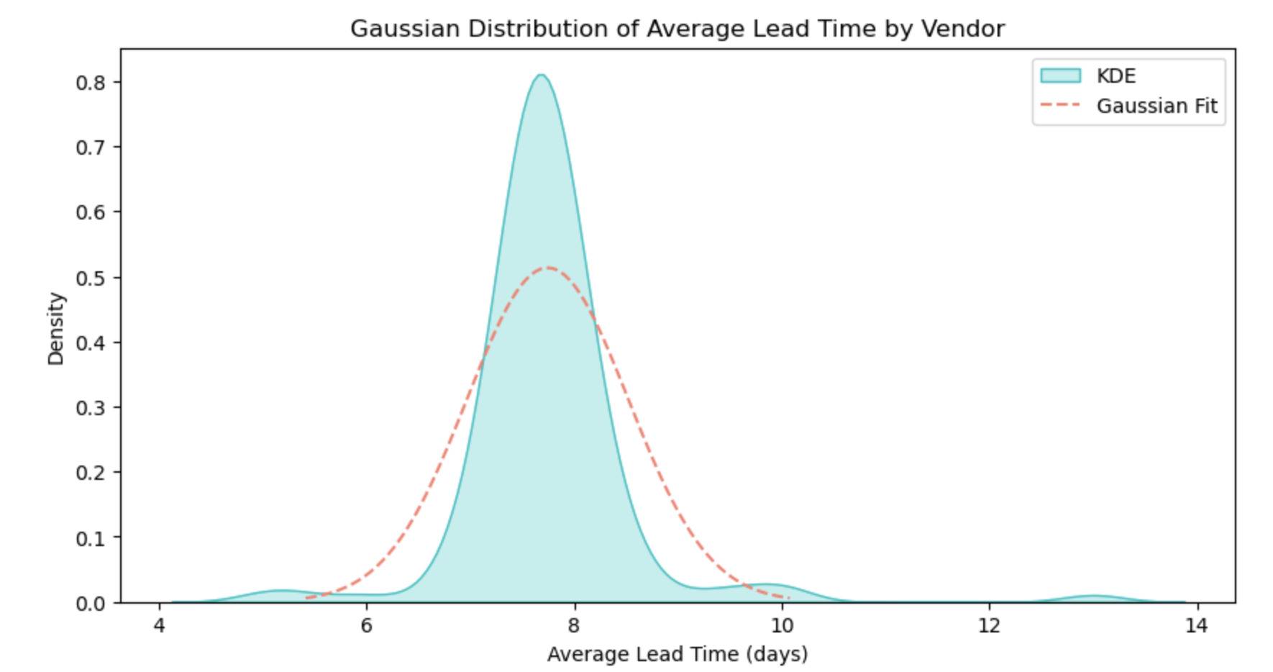
Delivery Lead Time for the Vendors
Most vendors seem to take about 7-8 days to deliver the products after a purchase order was placed.

Slide 17
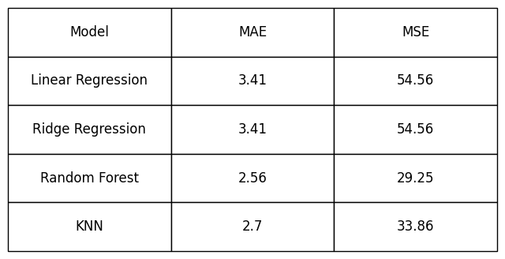
Demand Forecasting
Experiments with various models

Slide 18
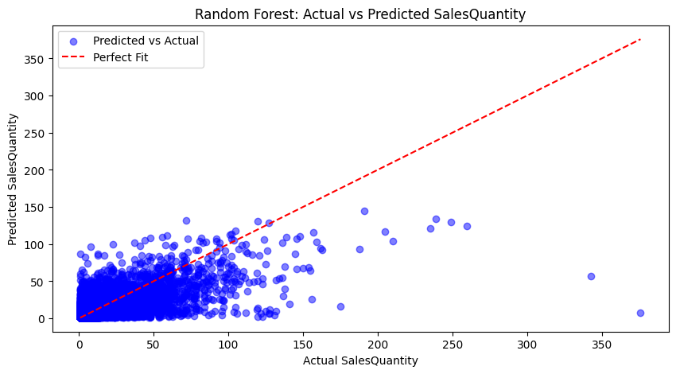
Demand Forecasting
Observations

